Slide 1
LATEST TRENDS IN TECHNOLOGY

Slide 3
SELFIE TECHNOLOGY
1. Priyn’t New Photo Printing Case
2. Drone
3. Selfie Mirror

Slide 4
1. Prynts New Photo Printing Case
Prynt is a smartphone case that doubles as an instant photo printer.
You can take pictures but you can also print pictures from Instagram, Facebook and any pictures that already on your smartphone.
These printing case usually fits to Iphone 6s, 6, 5s, 5c, and 5 also fits to Samsung Galaxy S5 and S4.
The photos take about 30 seconds to print.
You can also use the Prynt case to view “augmented reality” videos within your printed photos.
https://www.youtube.com/watch?v=u0IYVEMsNfw
https://www.youtube.com/watch?v=F1bAbfxVwDU

Slide 7
2. Drone
Drones are more formally known as unmanned aerial vehicles (UAV).
A drone is a flying robot.
The aircraft can be controlled or can fly freely through software-controlled flight plans.

Slide 9
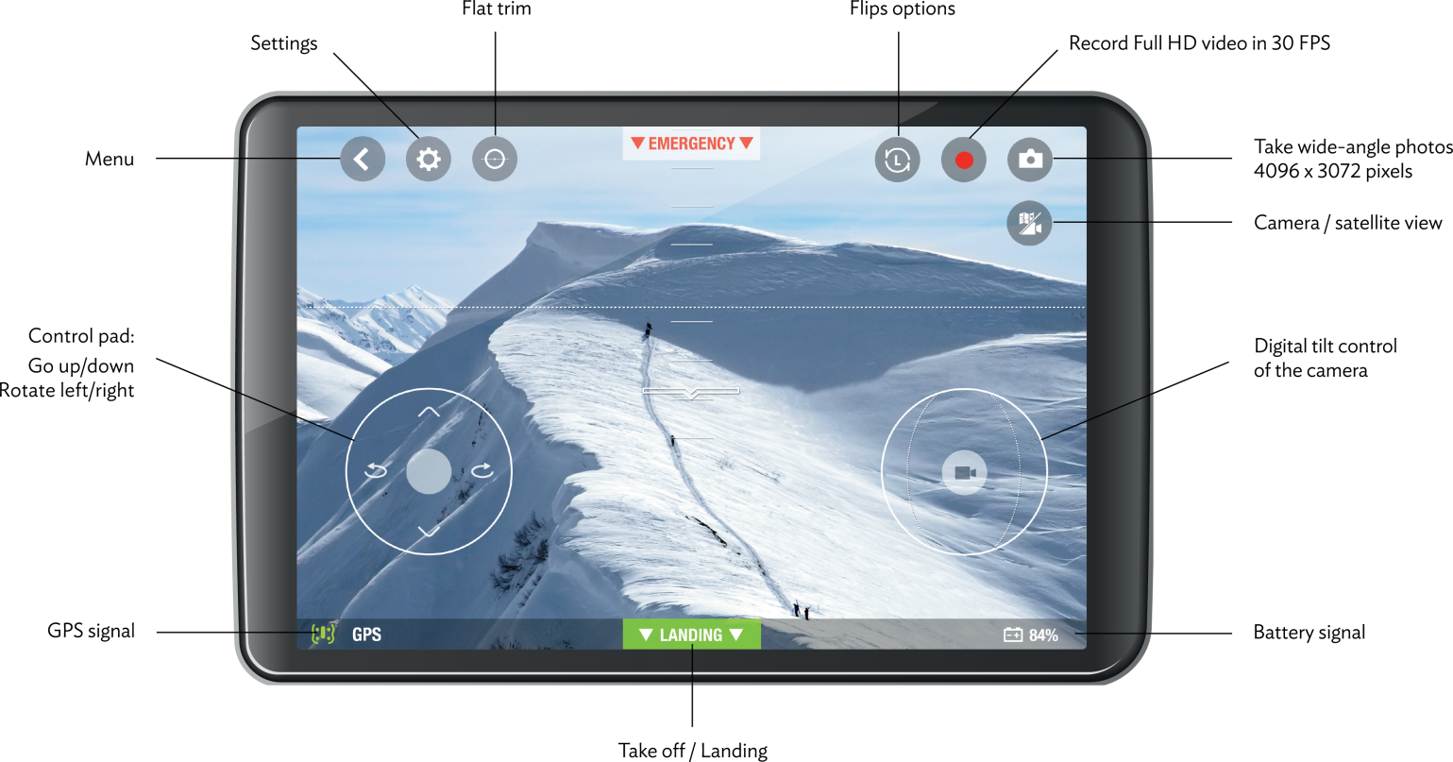
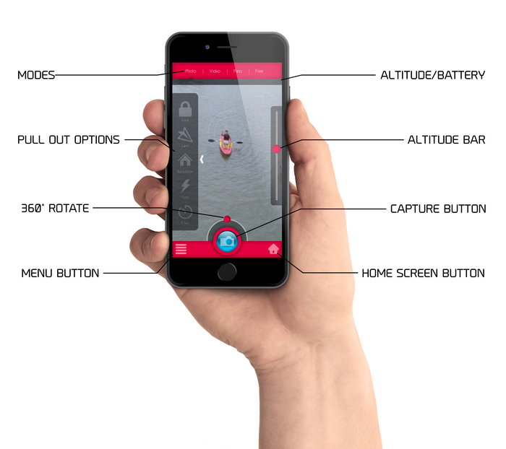

Slide 11
3. Selfie mirror
This is the first smart mirror, it has six features:
Hands free selfie
Home surveillance ( it has two way video communication)
Smart home
Information dashboard
Skype calls
Hi-fi sounds system
You can take a picture and post to your favorite social media. You can check news and weather, and make skype calls.
https://www.youtube.com/watch?v=uZzNbhaLHiQ&feature=youtu.be

